Slide 1
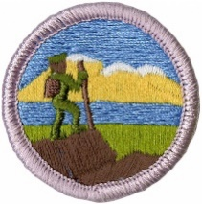
Hiking Merit Badge
Troop 344 and 9344
Pemberville, OH

Slide 2
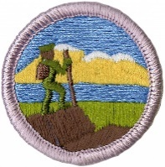
Hiking Merit Badge Requirements
Do the following:
  Explain to your counselor the most likely hazards you may encounter while hiking, and what you should do to anticipate, help prevent, mitigate, and respond to these hazards.
  Show that you know first aid for injuries or illnesses that could occur while hiking, including hypothermia, frostbite, dehydration, heat exhaustion, heatstroke, sunburn, hyperventilation, altitude sickness, sprained ankle, blisters, insect stings, tick bites, and snakebite.
Explain and. where possible, show the points of good hiking practices including proper outdoor ethics, hiking safety in the daytime and at night, courtesy to others, choice of footwear, and proper care of feet and footwear.
Explain how hiking is an aerobic activity. Develop a plan for conditioning yourself for 10-mile hikes, and describe how you will increase your fitness for longer hikes.

Slide 3
Hiking Merit Badge Requirements
Take the five following hikes, each on a different day, and each of continuous miles. These hikes MUST be taken in the following order
  One 5-mile hike
  Three 10-mile hikes
  One 15-mile hike
You may stop for as many short rest periods as needed, as well as one meal, during each hike, but not for an extended period (example: overnight). Prepare a written hike plan before each hike and share it with your Scoutmaster or a designee. Include map routes, a clothing and equipment list, and a list of items for a trail lunch. *
Take a hike of 20 continuous miles in one day following a hike plan you have prepared. You may stop for as many short rest periods as needed, as well as one meal, but not for an extended period (example: overnight). *
After each of the hikes (or during each hike if on one continuous "trek") in requirements 4 and 5, write a short reflection of your experience. Give dates and descriptions of routes covered, the weather, and any interesting things you saw. It may include something you learned about yourself, about the outdoors, or about others you were hiking with. Share this with your merit badge counselor.
* The required hikes for this badge may be used in fulfilling hiking requirements for rank advancement. However, these hikes cannot be used to fulfill requirements of other merit badges.

Slide 4
Requirement 1
Do the following:
  Explain to your counselor the most likely hazards you may encounter while hiking, and what you should do to anticipate, help prevent, mitigate, and respond to these hazards.

Slide 5

Hazards of Hiking
A truly effective approach to reducing risk comes from the willingness of every group member to take an active role in maximizing personal safety and the safety of others.
The more responsibility each person takes for his or her own health and safety, the more everyone can contribute to a successful trek.
To help minimize risk:
  Stay in good shape so you are ready for the physical demands of a trek.
  Know where you are going and what to expect.
  Adjust clothing layers to match changing weather conditions.
  Drink plenty of water.
  Take care of gear.
A critical aspect of managing risk is letting others know when you are having difficulties or are aware of a concern that might affect you or the group.
  Even if you feel hesitant to speak up, voicing concern about questionable route decisions or a developing hot spot, for example, can bring important matters to the group’s attention.

Slide 6
Requirement 1
Do the following:
  Show that you know first aid for injuries or illnesses that could occur while hiking, including hypothermia, frostbite, dehydration, heat exhaustion, heatstroke, sunburn, hyperventilation, altitude sickness, sprained ankle, blisters, insect stings, tick bites, and snakebite.

Slide 7

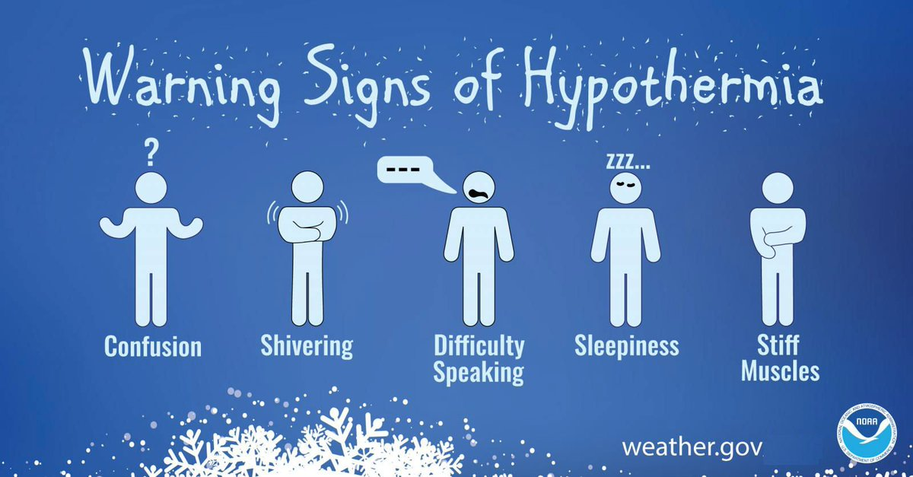
Hypothermia
Occurs when body cannot make heat as fast as it loses it.
Internal body temperature drops below 95ºF.
Can occur whenever and wherever a person feels cold, including indoors in poorly heated areas.

Slide 8
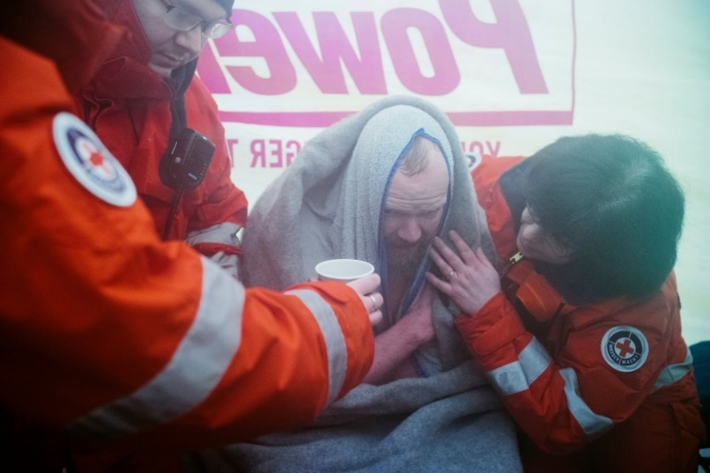
Hypothermia
Move victim to shelter.
Remove wet clothing and wrap victim in warm covers.
Apply direct body heat.
Re-warm neck, chest, abdomen, and groin first.
Give warm, sweet drinks if conscious.
Monitor breathing, administer CPR.
Get medical help.

Slide 9

Frost Nip
Frost nip is an earlier and milder case of frostbite. Usually the ears, cheeks, nose, fingers and toes are affected.
Skin white or numb.
Don’t rub – hold against a warm body part.
Change clothing and/or environment.
Frost nip is a warning that you are not keeping warm enough!

Slide 10
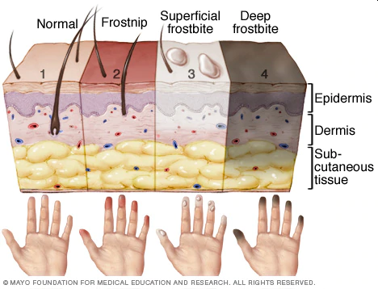
Frostbite
Mild Frostbite:
  Skin looks waxy and white, gray, yellow, or bluish.
  Area is numb or feels tingly or aching
Severe Frostbite:
  Area feels hard.
  May become painless
  After warming, area becomes swollen and may blister.

Slide 11
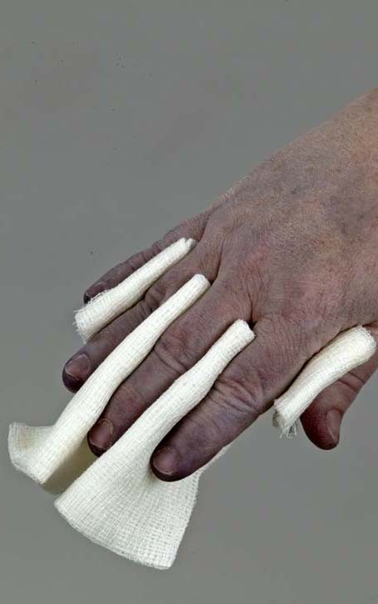
First Aid for Frostbite
Move victim to warm environment.
Hold frostbitten area in hands to warm – do not rub.
Remove any tight clothing or jewelry around area.
Put dry gauze or fluffy cloth between frostbitten fingers or toes.
Do not use heat lamp, campfire, or heating pad to rewarm.
Seek medical attention immediately.

Slide 12
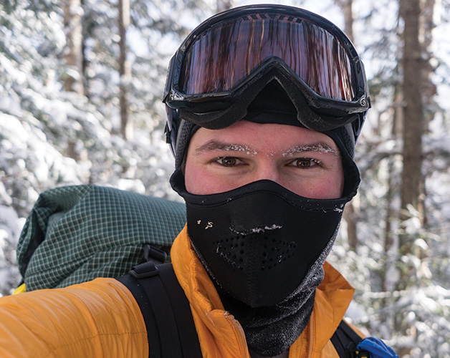
Prevention of Frostbite
Be sure you dress in layers for cold weather. The first layer should be thermal underwear, and the outer layer needs to be waterproof. The layers should be loose, not tight. Mittens are warmer than gloves.
You should wear a hat. Over 50% of a your body heat is lost from the head.
Set limits on the time spent outdoors when the wind-chill temperature falls below 0°F (-18°C).
Recognize the earliest warnings of frostbite. Tingling and numbness are reminders that your are not dressed warmly enough for the weather and needs to go indoors.

Slide 13

Dehydration
When the body puts out more liquid than it is taking in.
Ways we lose fluids:
  Sweating.
  Urination.
  Vomiting.
Signs of dehydration:
  Thirst.
  Yellow or dark urine.
  Dry mouth.
  Lightheadedness.
  Nausea and vomiting.
  Dry skin.
  Cease sweating.
Treatment:
  Drink fluids (water, Gatorade).
  Avoid physical activity.
  Get inside air conditioned or cool area.

Slide 14
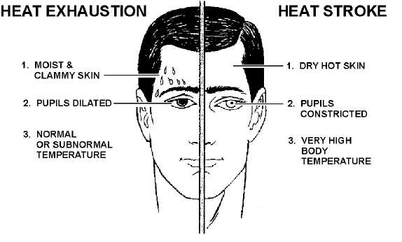
Heat Reactions

Slide 15
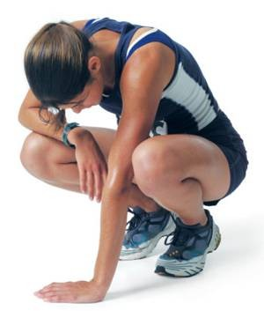
Heat Exhaustion Symptoms
Heavy sweating
Thirst
Fatigue
Heat cramps
Headache
Dizziness
Nausea
Vomiting

Slide 16

First Aid for Heat Exhaustion
Move victim from heat to rest in a cool place.
Loosen or remove unnecessary clothing.
Give water or a sports drink.
Raise feet 8-12 inches.
Put cool, wet cloths on forehead and body – spray skin with water.
Seek medical care if victim’s condition worsens or does not improve within 30 minutes.

Slide 17
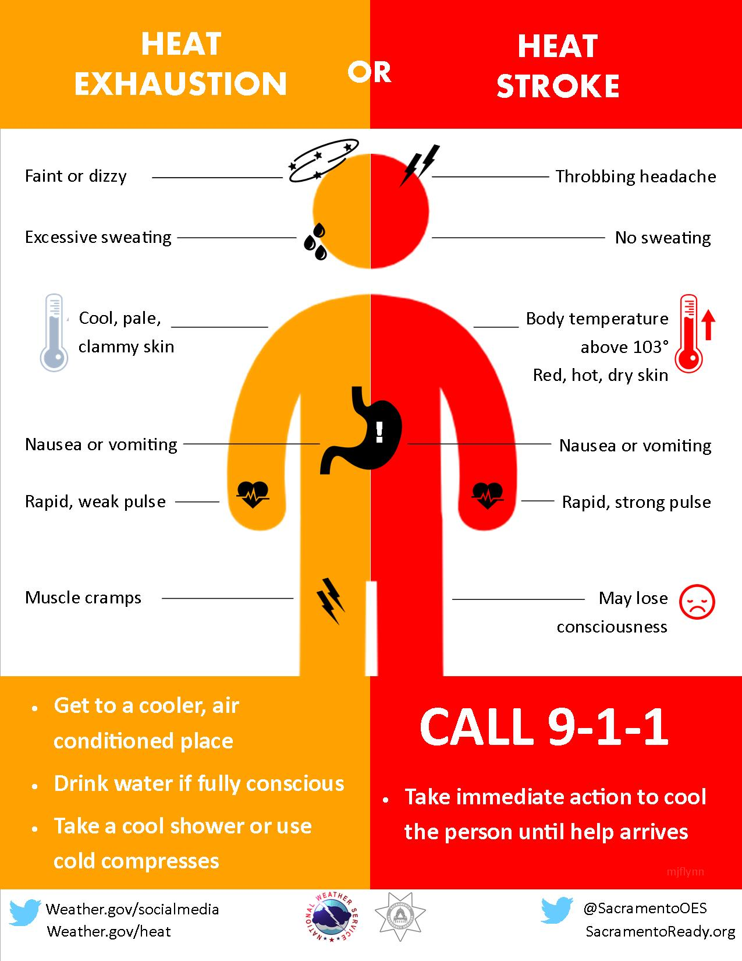

Slide 18
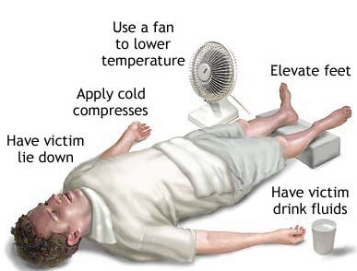
First Aid for Heat Stroke
Call 911.
Move victim to cool place.
Remove outer clothing.
Cool victim quickly.
Apply cold compresses or spray skin with water.
Put ice bags or cold packs beside neck, armpits, and groin.

Slide 19
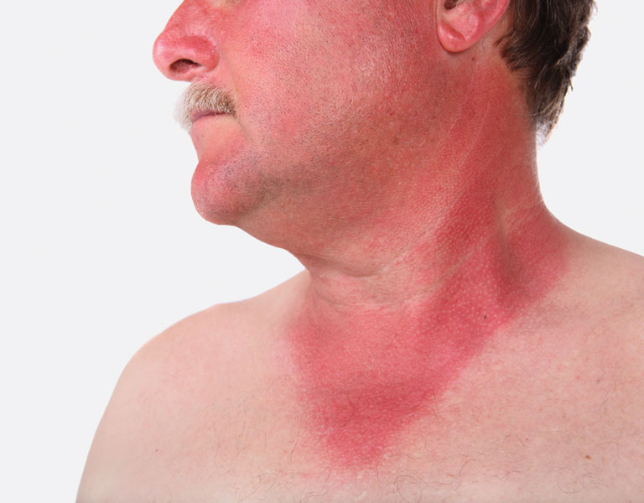
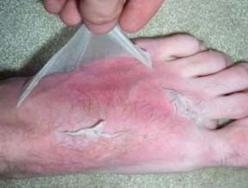
Sunburn
Severe sunburn can be a significant first aid situation.
Sunburn is preventable with protective ointments, clothing, or staying out of the sun.
Long term effects of sunburn has been linked to skin cancers.

Slide 20
First Aid for Sunburn
Symptoms:
  Redness.
  Minor inflammation, or swelling.
  Pain.
  Dry, peeling skin occurs as the burn heals.
Treatment:
  Soak the sunburn in cool water for five minutes or longer or take a cool shower.
  Take acetaminophen or ibuprofen for pain relief.
  Apply lidocaine (an anesthetic) with Aloe Vera to soothe the skin.

Slide 21

Hyperventilation
Abnormal increase in volume of air breathed in and out of the lungs..
Occurs during stressful situations such as infection, bleeding, or heart attack.

Slide 22
Hyperventilation Symptoms
Hyperventilation causes the carbon dioxide level in the blood to decrease.
This reduces blood flow to the brain, which may result in the following symptoms:
  Weakness.
  Tingling in fingers/toes.
  Dizziness/lightheadedness.
  Confusion.
  Agitation.
  Chest pain or fast and pounding heartbeat.
  Dry mouth.
  Nausea.
  Feeling as if you can't catch your breath.
Reaction to the symptoms causes even greater hyperventilation.

Slide 23
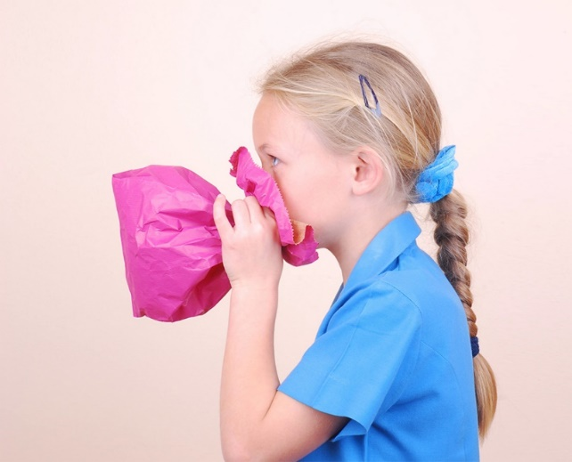
First Aid for Hyperventilation
Calm the person down by identifying the source of anxiety and addressing it.
  Hyperventilation is often triggered in wilderness settings by a fear of heights, equipment failures, or by a minor injury that causes anxiety.
Have the person breath into a stuff sack or other bag, covering both the nose and mouth with the bag. This will increase the amount of carbon dioxide in the blood.
If the person does not respond to treatment within 20 minutes, the ailment may be something other than hyperventilation. Other possibilities are asthma, heat exhaustion, and heat stroke.

Slide 24
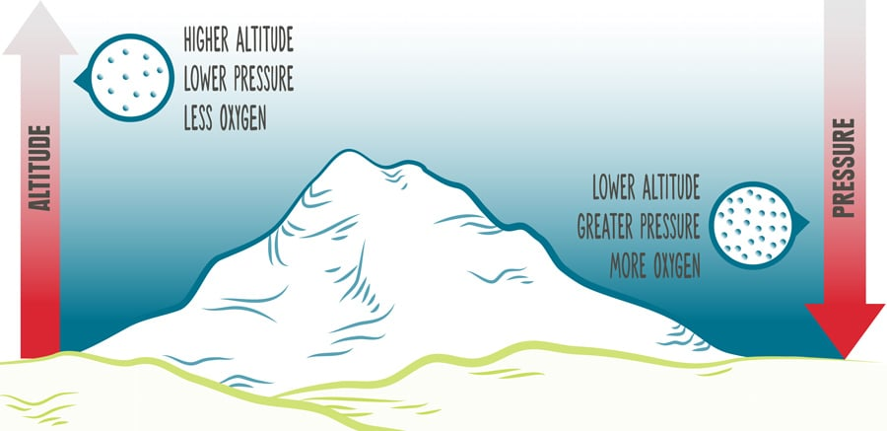
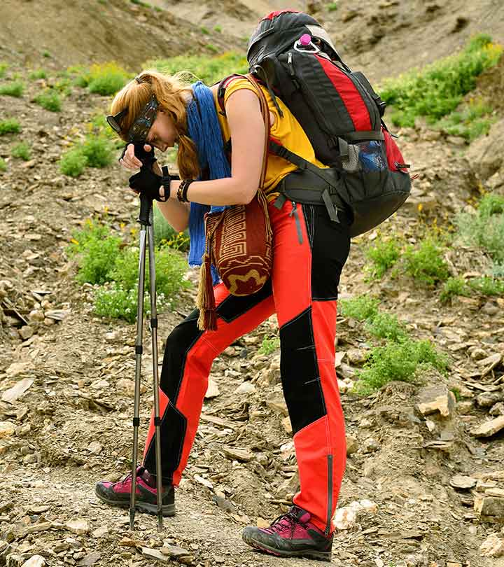
Altitude Sickness
Hiking may take you to high places where altitude sickness (also known as AMS, or Acute Mountain Sickness) can be a concern.
Altitude sickness is seldom a problem for people at elevations of less than 8,000 feet above sea level.
High altitudes may leave you short of breath due to less oxygen.
Your body will acclimate to higher altitudes within a few days by producing extra red blood cells to carry more oxygen.
To help prevent altitude sickness:
  Drink plenty of fluids.
  Ascend gradually and permit your body to acclimate as you go higher (increase your altitude by no more than 1,000 feet/day).

Slide 25
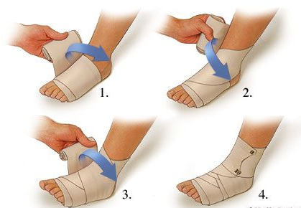
First Aid for Sprains
Immobilize area in position found.
Put ice or cold pack on area.
Wrap joint with compression bandage.
Use soft splint to immobilize and support joint.
Seek medical attention if appropriate.

Slide 26
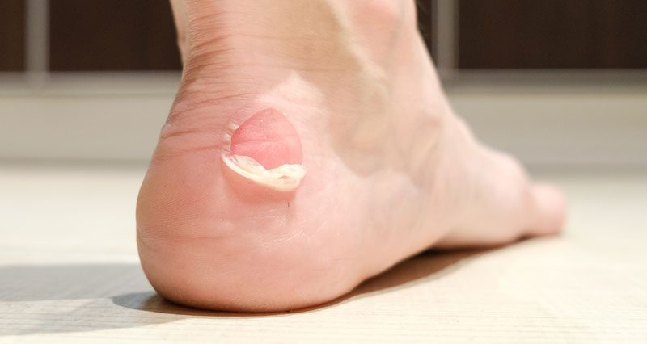
Blisters
A blister is skin injury that is usually filled with water.
Blisters commonly occur on the feet or hands.
They are most often caused by the hands or feet rubbing against something (such as wearing new shoes).

Slide 27
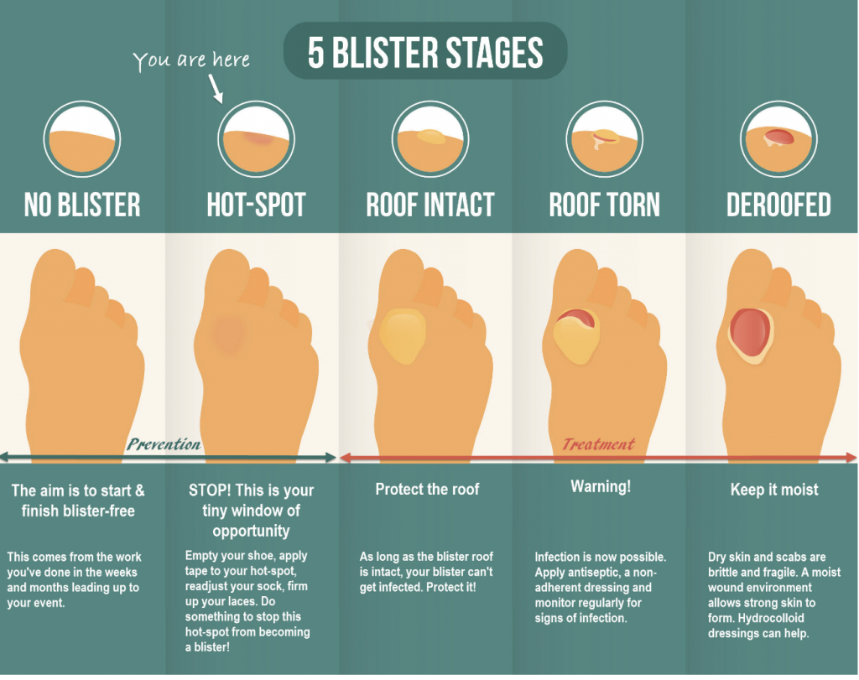

Slide 28
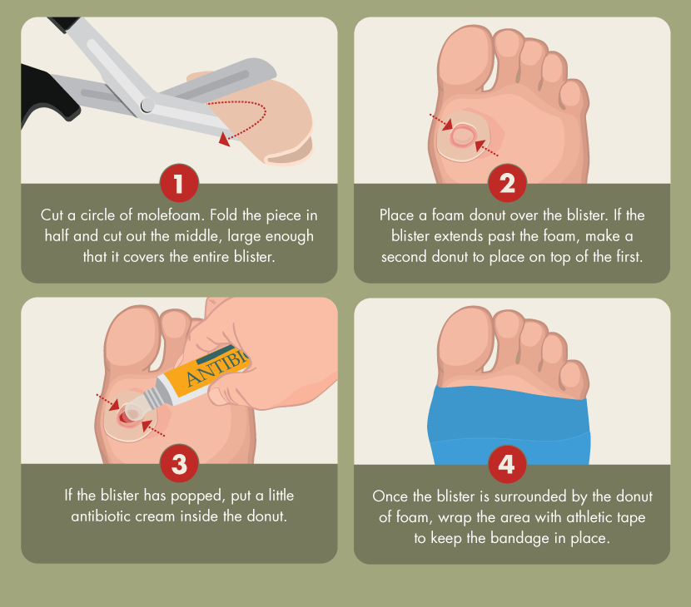
Treatment for Blisters
Do not open the blisters, since this increases the possibility of infection.
Clean the skin around it.
Take the pressure off the area by placing a Band-Aid over the blister or Moleskin with a hole cut in the center.
If the blister accidentally breaks open, trim off the loose skin.
Keep the surface clean by washing it twice a day with an antibacterial soap (such as Dial or Safeguard).
Apply an antibiotic ointment and a Band-Aid to help with healing.

Slide 29
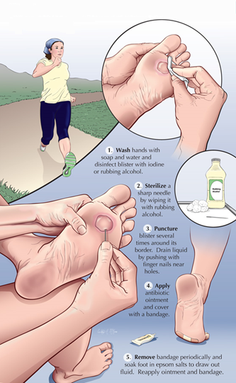
Popping a Blister
If a blister is in a frequently used area that has a high risk of rupturing, it may be best to pop it to make sure it’s properly protected against infection.
Wash your hands and the blister thoroughly.
Disinfect a needle with alcohol.
Carefully puncture the blister.
  Poke three or four shallow holes around the edge of the blister.
  You want to keep as much of the skin intact as possible.
  Allow the fluid to drain out.
Cover the blister with a first aid ointment such as Neosporin.
Apply a dressing.
  Cover the blister tightly with a bandage or gauze.
Repeat if necessary.
  You may need to perform these steps every six to eight hours for the first 24 hours.
  After that, change the dressing and apply ointment daily.

Slide 30
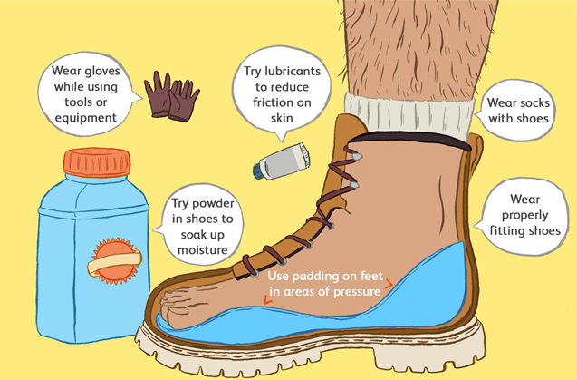
Preventing Blisters
Friction can also be reduced by wearing two pairs of socks.
Place Moleskin on sensitive areas were the friction may occur.

Slide 31
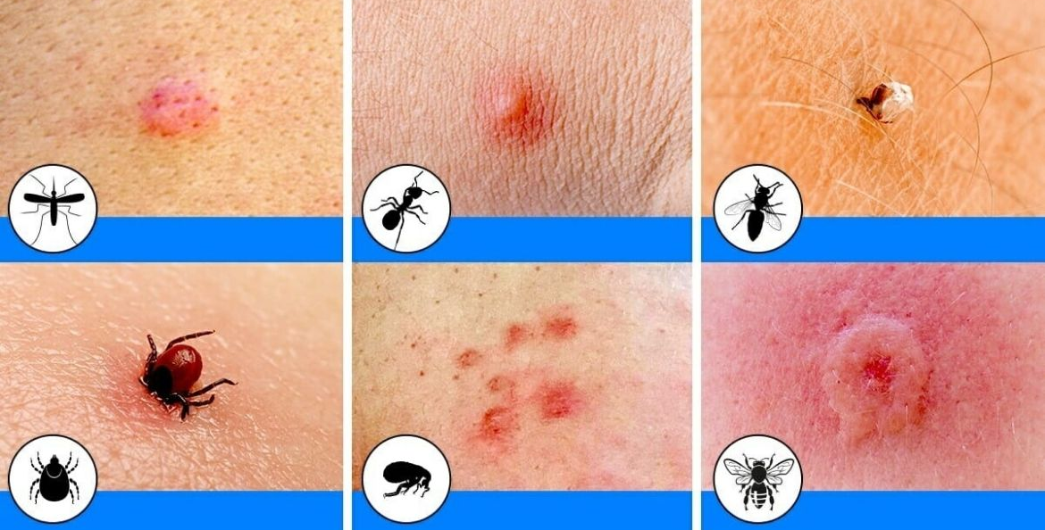
Insect Bites
Bites of mosquitoes and chiggers (harvest mites usually cause itchy, red bumps. The size of the swelling can vary from a dot to a half inch.
Signs that a bite is from a mosquito are: itchiness, a central raised dot in the swelling, a bite on skin not covered by clothing, and summertime,
Bites from horseflies, deerflies, gnats, fire ants, harvester ants, blister beetles, and centipedes usually cause a painful, red bump.
Fire ant bites change to blisters or pimples within a few hours.

Slide 32
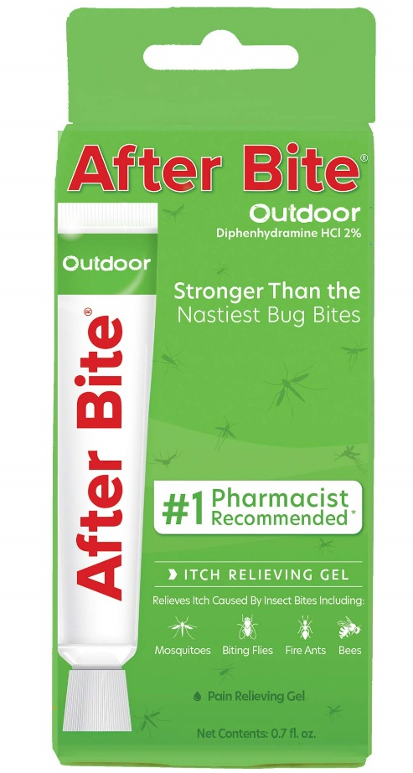
Treatment of Insect Bites
Apply calamine lotion or a baking soda paste to the area of the bite.
If the itch is severe (as with chiggers), apply nonprescription 1% hydrocortisone cream four times a day.
Do not to pick at the bites or they can become infected or leave scars.
Cold, moist compresses or ice on the area can help.

Slide 33
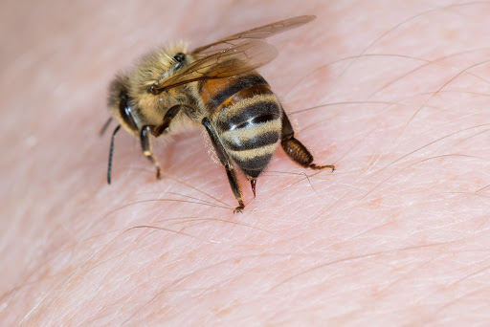
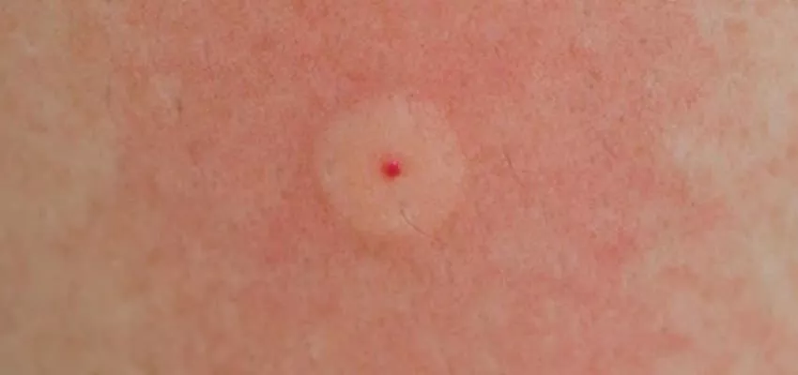
Bee Stings
Honey bees, bumble bees, hornets, wasps, and yellow jackets can all sting.
These stings cause immediate painful red bumps.
While the pain is usually better in 2 hours, the swelling may increase for up to 24 hours.

Slide 34
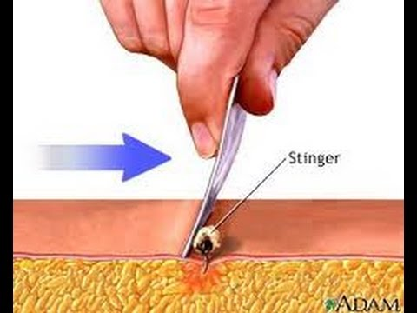
Treatment of Bee Stings
If you see a little black dot in the bite, the stinger is still present (this only occurs with honey bee stings).
Remove it by scraping it off with a credit card or something similar.
For persistent pain, massage with an ice cube for 10 minutes.
Give acetaminophen immediately for relief of pain and burning.
For itching, apply hydrocortisone cream.

Slide 35
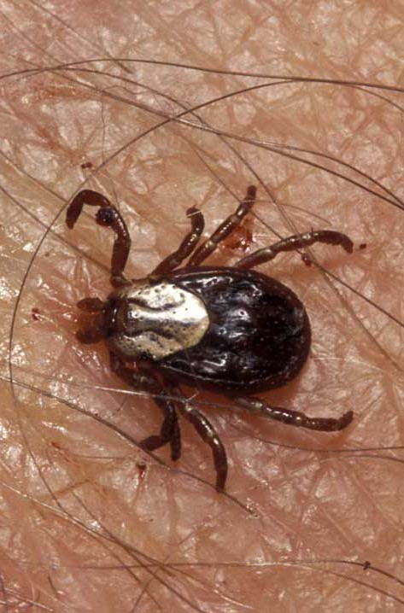
Tick Bites
Can transmit Rocky Mountain spotted fever or Lyme disease.
Tick embeds its mouth parts in skin and may remain for days sucking blood.

Slide 36
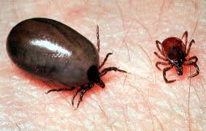
Engorged Tick

Slide 37
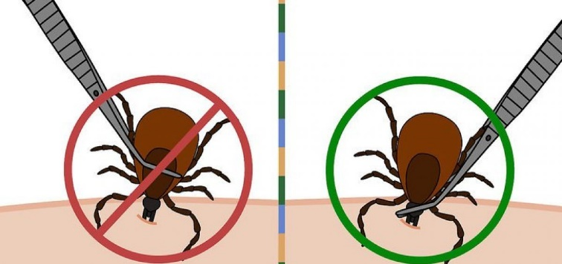
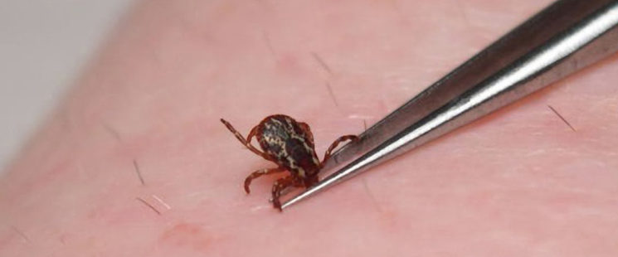
Tick Removal
Grasp the tick’s mouthparts against the skin, using pointed tweezers.
Pull steadily without twisting until you can ease the tick head straight out of the skin.
DO NOT squeeze or crush the body of the tick.
DO NOT apply substances such as petroleum jelly, nail polish, or a lighted match to the tick while it is attached.

Slide 38
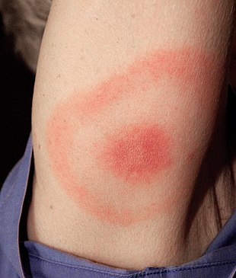
Tick Removal (cont.)
Once you have removed the tick, wash the wound site and your hands with soap and water, and apply rubbing alcohol or antiseptic to the site.
Observe the bite over the next two weeks for any signs of an expanding red rash or flu-like symptoms (Lyme Disease).
Lyme Disease Rash

Slide 39
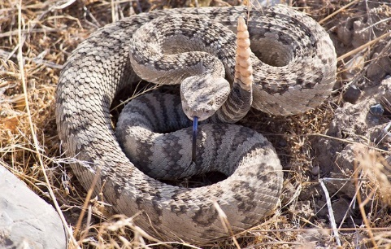
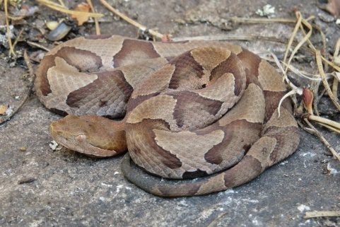
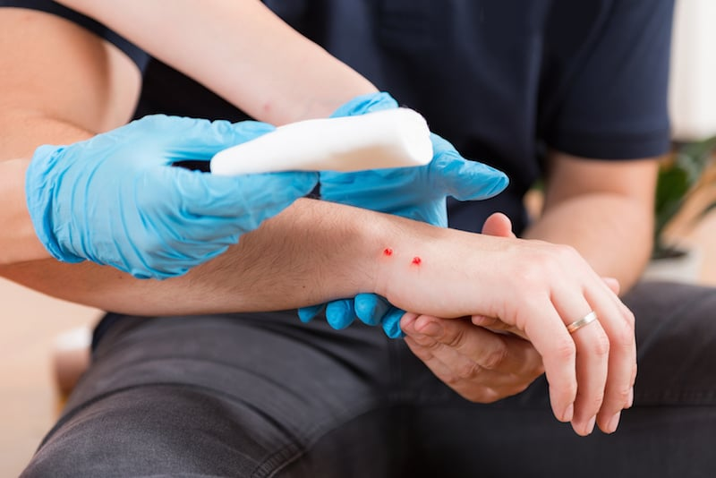
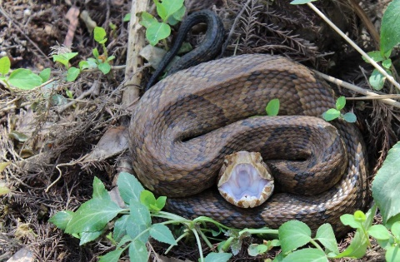
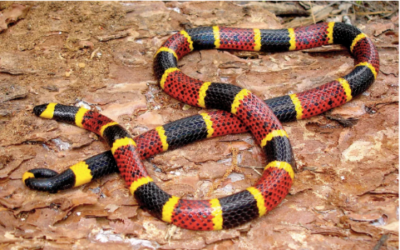
Poisonous Snakebite
In the U.S. the poisonous snakes are rattlesnakes, copperheads, cottonmouths, and coral snakes.
Currently about 8,000 people per year in the U.S. are bitten by a poisonous snake, of which about 6 will die.

Slide 40
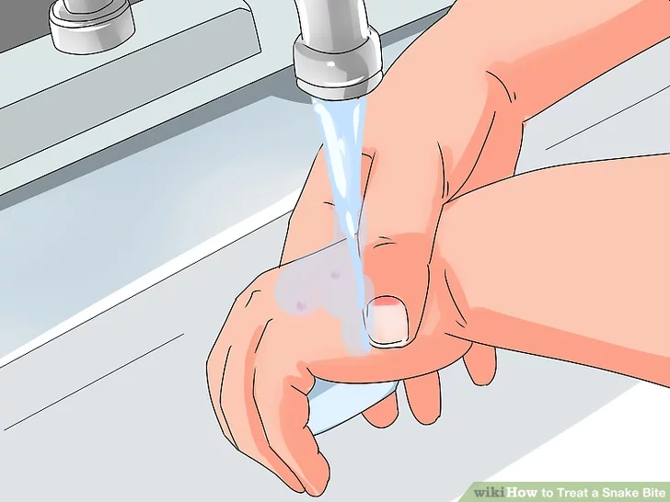
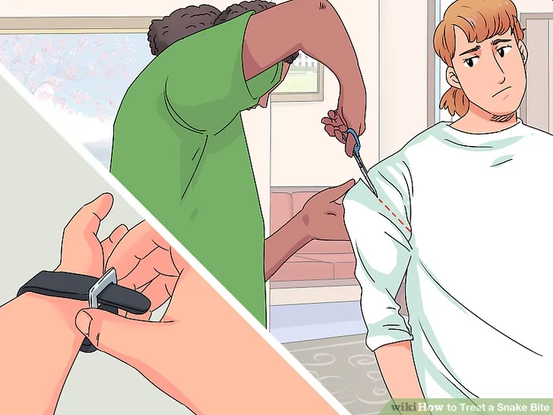
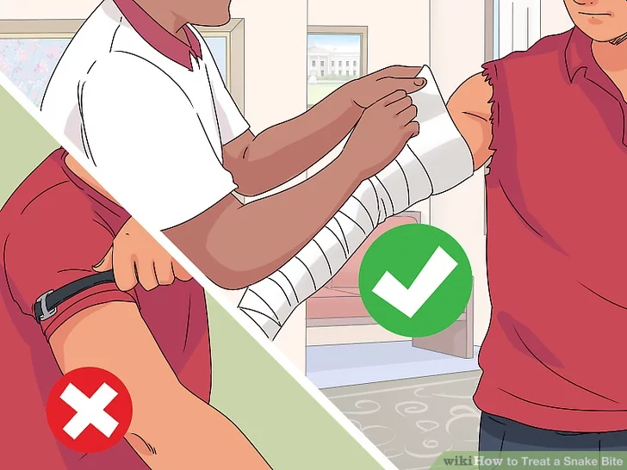
First Aid for Poisonous Snake Bites
Have victim lie down and stay calm.
Keep bitten area immobile and below level of heart.
Call 911.
Wash bite wound with soap and water.
Remove jewelry or tight clothing before swelling.
Do not try to catch snake but note appearance.
If possible, wrap entire extremity with elastic (compression) bandage to slow spread of venom.
Do not use a tourniquet.
Do not cut wound open to try to drain or suck venom out.

Slide 41
Requirement 2
Explain and, where possible, show the points of good hiking practices including proper outdoor ethics, hiking safety in the daytime and at night, courtesy to others, choice of footwear, and proper care of feet and footwear.

Slide 42

Outdoor Ethics
While hiking, it is important to remember that you’re sharing the space with other people and you should be aware of proper hiking etiquette in order to trek safely and respectfully.
Proper outdoor ethics go hand-in-hand with following the Outdoor Code and Leave No Trace principles.
The Outdoor Code simply states:
  As an American, I will do my best to—
  Be clean in my outdoor manners.
  Be careful with fire.
  Be considerate in the outdoors.
  Be conservation-minded.

Slide 43

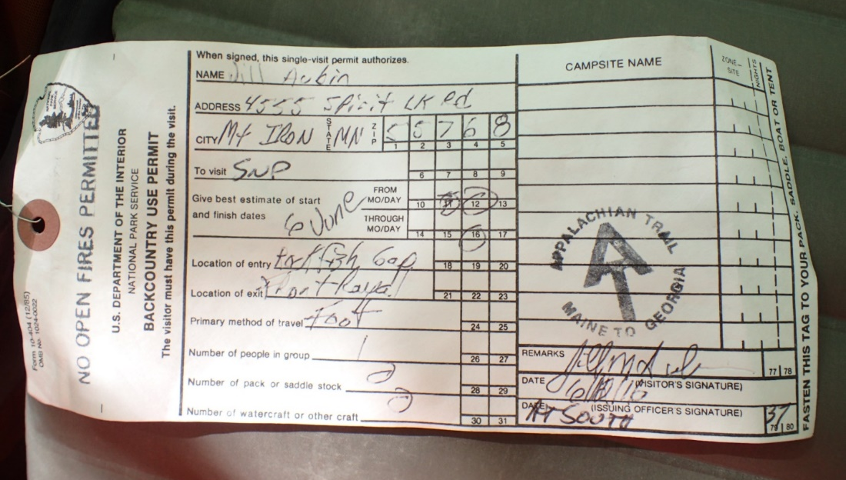
Leave No Trace Principles
Plan Ahead and Prepare. When planning your hike, contact the land managers of the area you intend to visit or the Leave No Trace Center for Outdoor Ethics.
Explain your desired route and ask how you can best implement Leave No Trace.
Here are some additional guidelines to remember.
  Know the regulations and special concerns for the area you will visit.
  Prepare for extreme weather, hazards, and emergencies.
  Schedule your trip to avoid times of high use.
  Visit the backcountry in small groups no larger than parties of four to six hikers.

Slide 44
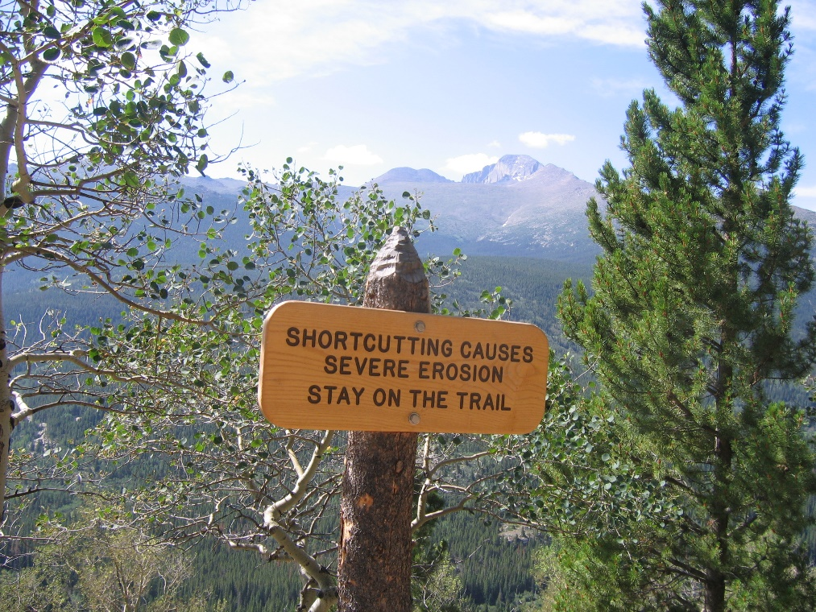
Leave No Trace Principles
Travel on Durable Surfaces. Stay on existing pathways to help protect the surrounding landscape from being trampled, eroded, and compacted.
  In popular areas, hike on durable surfaces such as established trails, rock, gravel, dry grasses, and snow. Taking shortcuts will damage the grooming of the trail and cause erosion.
  Protect shoreline vegetation.
  Walk single file in the middle of the trail, even if it is wet or muddy.
  Conduct activities in areas where vegetation is absent.

Slide 45

Leave No Trace Principles
Dispose of Waste Properly. Pack it in, pack it out. Make it easier on yourself by limiting the amount of potential trash you take.
Especially important is the disposal of human waste. Use toilet facilities whenever possible. If toilet facilities are not available:
  Urinate away from trails, camps, and other gathering places. Choose rocks or bare ground; animals may strip vegetation in order to consume the salts left by concentrations of urine.
  Pack out solid waste, or use a cathole. Check with the land agency for the area you will visit to find out the preferred method.
  To dig a cathole, choose a remote spot at least 200 feet from camps, trails, water, and dry gullies. With a trowel, dig a hole 6 to 8 inches deep in the topsoil. Take care of business, re-cover the hole, and disguise the site with leaves or other ground cover. Organic material in the topsoil will slowly break down the waste, making it harmless.

Slide 46
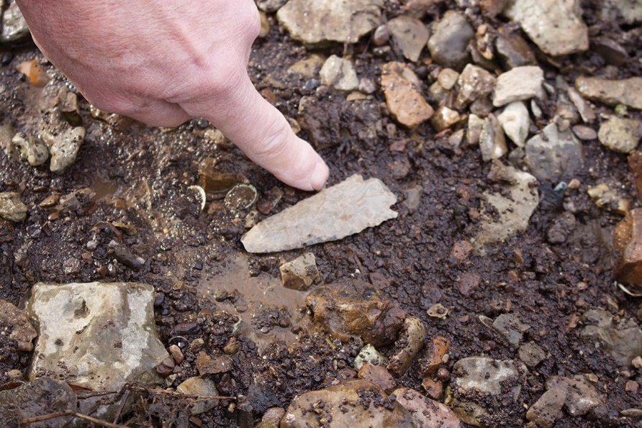
Leave No Trace Principles
Leave What You Find. Every hike will bring with it a new discovery to see and enjoy.
Here are some reasons why you should leave what you find.
  Future hikers will have the excitement of discovering for themselves what you have found.
  Plant and wildlife environments will not be harmed. Leave rocks and other natural objects as you find them. Avoid introducing or transporting nonnative species.
  Archaeological, cultural, and historic structures and artifacts preserve a record of America’s past; some are sacred to American Indians and other Native Americans. Observe, but do not touch or take.

Slide 47
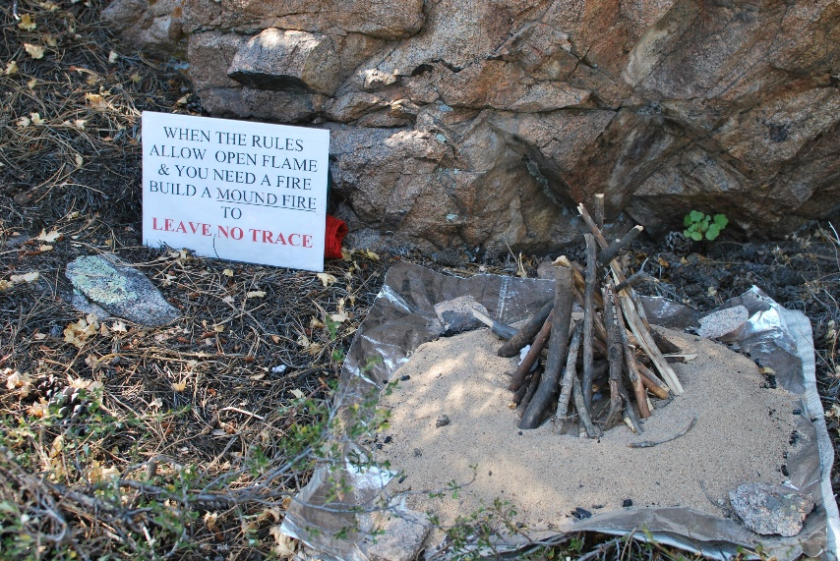
Leave No Trace Principles
Minimize Campfire Impacts. Most hikers are prepared to spend a day outdoors without needing a campfire.
If you do expect to cook or get warm, plan ahead with options that do not depend on kindling a blaze.
In any case, it is wise to know when a campfire can be lit and when a fire could scar the land.
In many areas, fires are discouraged, prohibited, or allowed by permit only.
If you must make a campfire:
  Use established fire rings, fire pans, or mound fires.
  Keep fires small. Use only sticks from the ground that can be broken by hand.
  Burn all wood and coals to ash, make sure the ashes are cold out, then scatter the cool ashes.

Slide 48
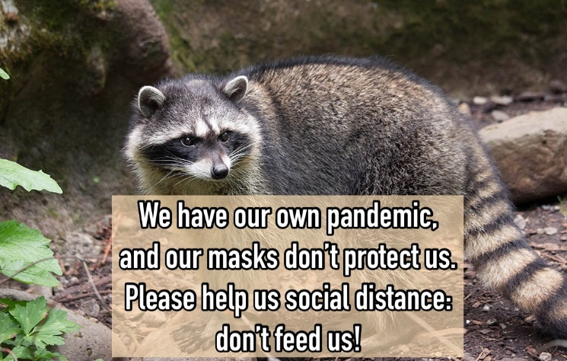
Leave No Trace Principles
Respect Wildlife. Sharing the outdoors with wildlife is one of the great pleasures of hiking.
Respect wildlife by always traveling quietly and observing animals from afar.
You are too close if your actions cause an animal to change its activities.
Always avoid wildlife when they are mating, nesting, raising young, and during other sensitive times.
Never feed wild animals.
Doing so damages their health, alters natural behaviors, and exposes them to predators and other dangers.
Store all your food and trash securely.

Slide 49
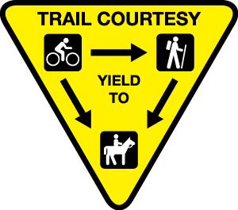
Leave No Trace Principles
Be Considerate of Other Visitors. Extending courtesy to other outdoor visitors is a natural habit of hikers. Speak softly and respect their desire for quiet and solitude. Leave radios and electronic devices at home. If you carry a mobile telephone for emergency communication, turn it off and stow it in your pack until you need it. Appreciate the company of those you meet on the trail and at campsites near yours.
Observe proper trail etiquette. If you encounter horseback riders or pack animals, stop and ask the lead rider what you should do. The lead rider will probably ask you to step a few paces downhill from the trail and stand quietly while the animals pass.
If you encounter other hikers or backpackers going uphill when you are going downhill, give them the right-of-way. Step aside on a rock or a log to minimize your impact, and watch your footing when you step below the trail.

Slide 50
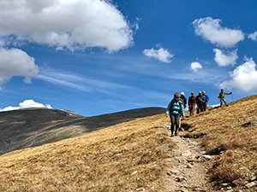
Hiking Safety
To ensure a safe hike, always keep the following points in mind:
  When hiking, always let someone know of your plans.
  Prepare thoroughly, obtain trail maps, and know your route beforehand.
  Never hike alone and always keep a pace that’s comfortable for the slowest member.
  Make sure to stay hydrated and bring more than enough water and equipment.
  Stay on the trail.
  Pack as lightly as possible.
  Always check the weather forecast before leaving.
  You should always bring a cell phone in case of emergencies.

Slide 51
Hiking Safety
Whenever you hike on a road, a few simple precautions will help keep you safe.
  Walk single file on the left shoulder so that you can see oncoming traffic.
  Wear light-colored and reflective clothing to help drivers notice you. Even better are bright orange vests such as those worn by highway workers and hunters.
  Be ready, if necessary, to step onto the shoulder of the road to give vehicles plenty of room.
  When you want to cross a road, line up alongside one another and have everyone cross at the same time.

Slide 52
Hiking Safety
Hiking during daylight hours is usually the best way to go.
You can see where you are headed, and others, especially motorists, can easily see you.
If you are caught out after dark and cannot safely continue—perhaps the trail is difficult to follow, or group members have become tired, hungry, and chilled—it may be best to stop for the night.
Use your Outdoor Essentials, good sense, and any other resources to keep your group safe and comfortable until you can move on in the morning light.
When hiking at night, there are other key safety points that you should keep in mind:
  Bring a headlamp as well as other backup lights.
  Pack warmer clothing than you normally would.
  Hike a trail that you’re familiar with so that you don’t get lost.
  Try to plan your hike around a full moon, the time of month when the natural light is brightest.
  Know your gear, as well as its location in your backpack.
  Night hiking helps you avoid the heat and allows you to see you some beautiful constellations that you’d otherwise miss when hiking during the day.

Slide 53
Proper Footwear for Hiking
When hiking, your footwear is the only thing that separates your feet from miles and miles of solid ground
It is essential to take the time to choose the best shoes for your hiking activities.
When choosing the right footwear for a long outdoor trek, you should consider the following points:
  Support: Having proper support means choosing a shoe that provides cushion, shock absorption, and ankle protection. Having good support is critical, as it will prevent you from getting ankle and leg injuries during long and challenging hikes.
  Sole: Your shoe’s sole will impact the durability, breathability, and stiffness of your footwear. Be sure to choose a boot whose soles have solid traction, as hiking trails can often be slippery.
  Fit: Having the right size of shoes will prevent rubbing and make for a much more comfortable hike. The right fitting hiking footwear will be snug but not too tight, as your feet will expand during the trek.

Slide 54
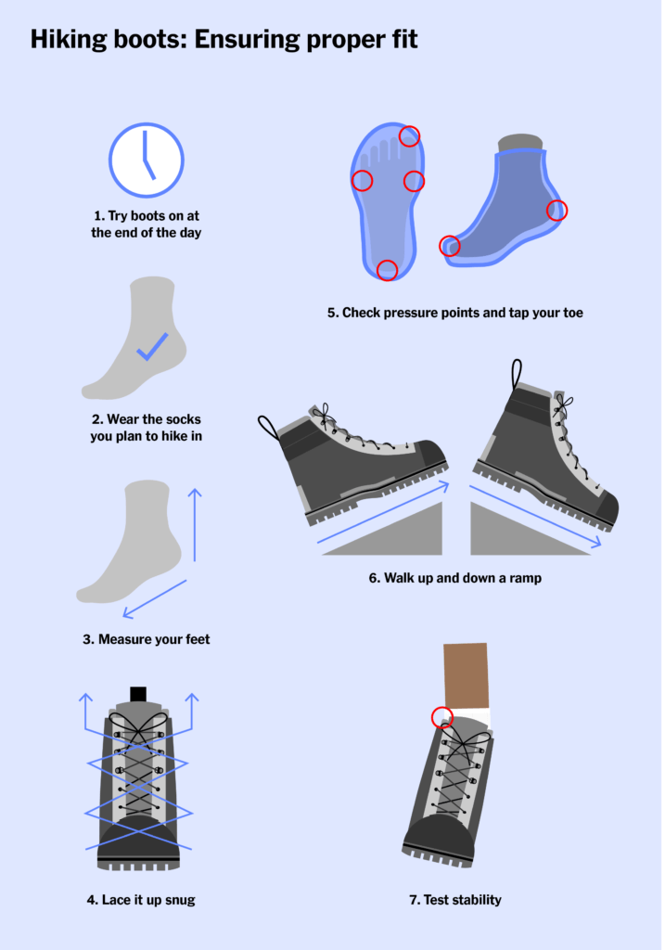
Hiking Boots: Ensuring the Proper Fit
Before your trip, make sure to break your boots in!
  Wear your boots inside the house. Wear the socks and insoles you’ll be wearing on the trail and tie your boots snugly, but not too tight. Make sure your tongues and gussets are straight. Your new boots will be a little stiff at first, which is fine.
  Walk around the block and around town. Make sure your boots feel good at each stage before upping the distance.
  Put on a daypack and hit the trail. Off pavement is where serious breaking in happens. Be sure you gradually increase both weight and mileage throughout this phase.

Slide 55
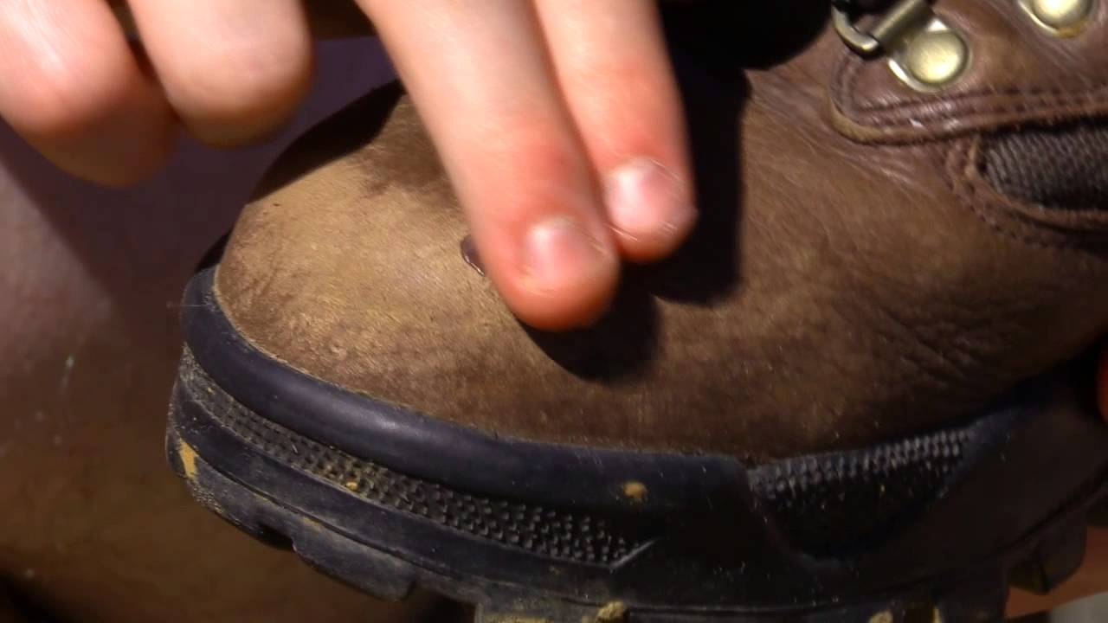
Proper Care of Footwear
If you buy the right shoes, they should be able to last for years if properly cared for.
By taking a few minutes after every hike to clean and dry your shoes, they’ll be as good as new the next time you’re ready to use them!
Watch this video on how to correctly care for your hiking shoes by clicking on the image.

Slide 56
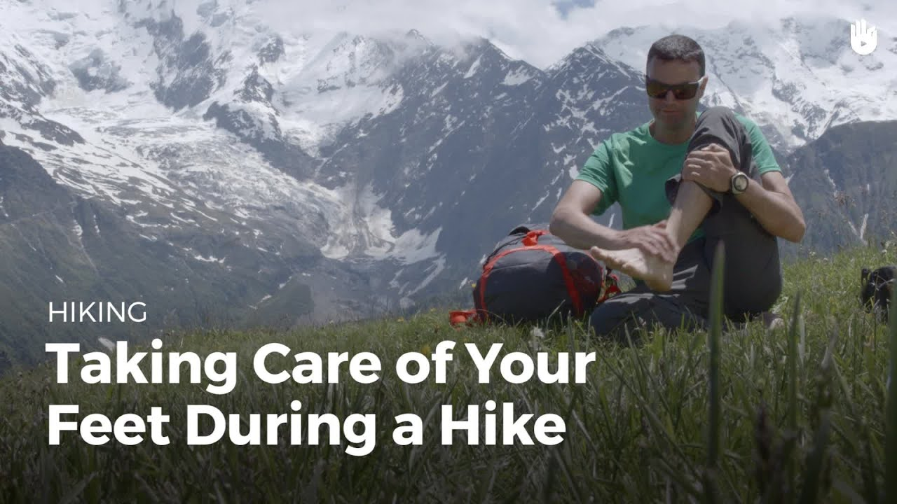
Proper Care of Feet
Taking care of your feet during a hike is just as important as maintaining your boots.
Always keep your feet dry and protected to avoid any sort of skin irritations or infections.
Nothing makes a hike more miserable than having issues with your feet.
Watch a this video for a brief overview of how you can easily take care of your feet while on a hike by clicking on the image.

Slide 57
Requirement 3
Explain how hiking is an aerobic activity. Develop a plan for conditioning yourself for 10-mile hikes, and describe how you will increase your fitness for longer hikes.

Slide 58
Hiking as an Aerobic Activity
The word aerobic means “with oxygen.”
Aerobic activities increase the rate of your breathing and your heartbeat, and push your body to use oxygen more efficiently.
Aerobic training can strengthen your circulatory and respiratory systems, add mass to muscles and bones, burn excess fat, and lead to improvements in overall fitness.
For aerobic activities to be effective, you must take part in them for half an hour or more at least three times a week, maintaining enough intensity to break a light sweat.
To enjoy hiking to the fullest, you will want to be in good shape.
Develop a plan for conditioning yourself by beginning with short trips, increasing the length of your journeys as you become more fit.

Slide 59

Conditioning Plan
Watch this video for more information on how you can build endurance and improve your conditioning for upcoming hikes by clicking on the image.

Slide 60
Requirement 4
Take the five following hikes, each on a different day, and each of continuous miles. These hikes MUST be taken in the following order
  One 5-mile hike
  Three 10-mile hikes
  One 15-mile hike
You may stop for as many short rest periods as needed, as well as one meal, during each hike, but not for an extended period (example: overnight). Prepare a written hike plan before each hike and share it with your Scoutmaster or a designee. Include map routes, a clothing and equipment list, and a list of items for a trail lunch. *

Slide 61
Hiking Plans
Trip Plans
A trip plan prepares you for the challenges of a hike, a campout, or any other outdoor activity. Write down the five W’s of a trip plan:
  Where are you going? Decide on a route to your destination and back. For backcountry trips, include a copy of a map with your route marked in pencil.
  When will you return? If you are not back reasonably close to the time on your trip plan, Scout leaders and family members can take steps to locate you and, if necessary, provide assistance.
  Who is hiking with you? List the names of your partners. If you need a ride to or from a trail, write down who will do the driving.
  Why are you going? To fish in a lake? Climb a peak? Explore a new area? Write a sentence or two about the purpose of your journey.
  What are you taking? Always carry the Outdoor Essentials. If you are camping out, you may need additional food, gear, and shelter.
Download a copy of “Hiking Trip Plan” to fill out for your hikes.

Slide 62


Slide 63

Clothing and Equipment Lists
Clothing for Warm-Weather Hiking
  Wicking shirt
  T-shirt
  Hiking shorts
  Long pants
  Sweater or warm jacket
  Sturdy shoes or hiking boots
  Socks
  Hat with a brim for shade
  Bandanna
  Rain gear (poncho or parka, pants)

Slide 64

Clothing and Equipment Lists
Clothing for Cold-Weather Hiking (Dress in Layers)
  Long-sleeved shirt
  Long pants (fleece or wool)
  Sweater (fleece or wool)
  Long underwear (polypropylene)
  Sturdy shoes or hiking boots
  Socks (wool or synthetic blend)
  Warm hooded parka or jacket
  Stocking hat (fleece or wool)
  Mittens or gloves (fleece or wool) with water-resistant shells
  Bandannas

Slide 65

Clothing and Equipment Lists
The Outdoor Essentials
  Pocketknife
  First-aid kit
  Extra clothing
  Rain gear
  Water bottle
  Flashlight
  Trail food
  Matches and fire starters
  Sun protection
  Map and compass

Slide 66


Clothing and Equipment Lists
Pack – A fanny pack or day pack will hold everything you need during a hike. If you use a small pack to carry your books to school, it will probably be fine to use for hiking, too.
Sticks and Trekking Poles – A hiking stick can add rhythm and balance to your stride. Use it to measure the depth of a stream and to help maintain better balance. A pair of trekking poles has the effect of putting a hiking stick in each of your hands. They are a great aid to balance, especially over rough ground, on snow, or when you are tired.

Slide 67

Food
Hiking burns energy.
Keep your body well-fueled by having a nutritious breakfast before a hike, and then carrying food that will provide the calories you need throughout the day.
You may want to take a bag of trail mix to nibble on while you walk.
  Granola is the choice of many hikers.
  So is GORP—good old raisins and peanuts.
  Apples, oranges, carrots, and bananas are fine snacks, too.
A solid lunch will see you through the middle of the day.
Sandwiches, fruit, carrots, nuts, and raisins are all tasty.
Instead of sandwiches, you might try crackers with cheese or peanut butter.

Slide 68

Water
Water is even more important to a hiker than food.
Fill at least one water bottle before you start out, and sip from it often.
In hot weather, you may need to carry several water containers.
Treat any water taken from streams, lakes, or springs before you drink it.

Slide 69
Requirement 5
Take a hike of 20 continuous miles in one day following a hike plan you have prepared. You may stop for as many short rest periods as needed, as well as one meal, but not for an extended period (example: overnight). *

Slide 70

20 Mile Hike Plan
Download a copy of “Hiking Trip Plan” to fill out for your 20 Mile Hike.

Slide 71
Requirement 6
After each of the hikes (or during each hike if on one continuous "trek") in requirements 4 and 5, write a short reflection of your experience. Give dates and descriptions of routes covered, the weather, and any interesting things you saw. It may include something you learned about yourself, about the outdoors, or about others you were hiking with. Share this with your merit badge counselor.

Slide 72

Hiking Reflections
Your reflections can be short passages (200-250 words). Make sure you give dates and descriptions of routes covered, the weather, and any interesting things you saw. It may include something you learned about yourself, about the outdoors, or about others you were hiking with. Include pictures from the hike, as well as some of the other highlights from the trail.

